Slide 1
ANTI VIRAL

Slide 2
Antiviral drugs are a class of medication used for treating viral infections. Most antivirals target specific viruses, while a broad-spectrum antiviral is effective against a wide range of viruses.
For example, amantadine (Symmetrel) is a synthetic antiviral. It acts by inhibiting the multiplication of the influenza A virus. It was used to lessen the severity of the disease, particularly in individuals at high-risk such as those who are immunosuppressed or in a nursing home. Amantadine has been replaced by safer medicines, oseltamivir (Tamiflu) and zanamivir (Relenza) which have fewer side effects.
Ribavirin , diphtheria, pertussis, and tetanus (DTaP), measles, mumps, rubella (MMR), varicella (chickenpox), hepatitis B, rotavirus, polio

Slide 3
Antitussives are medicines that suppress coughing, also known as cough suppressants. Antitussives are thought to work by inhibiting a coordinating region for coughing located in the brain stem, disrupting the cough reflex arc; although the exact mechanism of action is unknown.
DRUG | DRUG DESCRIPTION
Codeine | An opioid analgesic used to treat moderate to severe pain when the use of an opioid is indicated.
Dextromethorphan | An NMDA receptor antagonist used to treat cases of dry cough.
Hydrocodone | An opioid agonist used as an analgesic and antitussive agent.
Methadone | An opioid analgesic indicated for management of severe pain that is not responsive to alternative treatments. Also used to aid in detoxification and maintenance treatment of opioid addiction.

Slide 4
Anti-Allergic
Agents that are used to treat allergic reactions. Most of these drugs act by preventing the release of inflammatory mediators or inhibiting the actions of released mediators on their target cells.
DRUG | DRUG DESCRIPTION
Triprolidine | A sedating antihistamine combined with pseudoephedrine and guaifenesin in various types of cold and allergy medications to relieve allergy symptoms, hay fever and common cold symptoms, and to aid in sleep.
Tripelennamine | A histamine H1 antagonist used to treat hypersensitivity reactions, coughs, and the common cold.
Tranilast | For the treatment of bronchial asthma, keloid and hypertrophic scar, and allergic disorders such as asthma, allergic rhinitis and atopic dermatitis.

Slide 5
Anti-diabetic
Drugs used in diabetes treat diabetes mellitus by altering the glucose level in the blood. With the exceptions of insulin, exenatide, liraglutide and pramlintide, all are administered orally and are thus also called oral hypoglycemic agents or oral antihyperglycemic agents.
Sulfonylureas
Insulin secretion can be stimulated with sulfonylureas (SU) or meglitinides, of which the first ones are the longer acting ones, and the meglitinides the prandial insulin releasers. These agents stimulate insulin secretion by acting on the K+ ATP channel on the surface of the pancreatic β-cell. They induce weight gain and confer a risk of hypoglycemia

Slide 6
Insulin
If glycemic control cannot be achieved with each or all of the agents mentioned above, insulin therapy can be given. Insulin affects many of the defects in T2DM; it lowers hepatic glucose production, increases glucose uptake in the muscle, lowers lipolysis from adipose tissue, enhances protein anabolism and affects growth.
Anti hypertensives
There are many classes of antihypertensives, which lower blood pressure by different means. Among the most important and most widely used medications are thiazide diuretics, calcium channel blockers, ACE inhibitors, angiotensin II receptor antagonists (ARBs), and beta blockers.

Slide 7
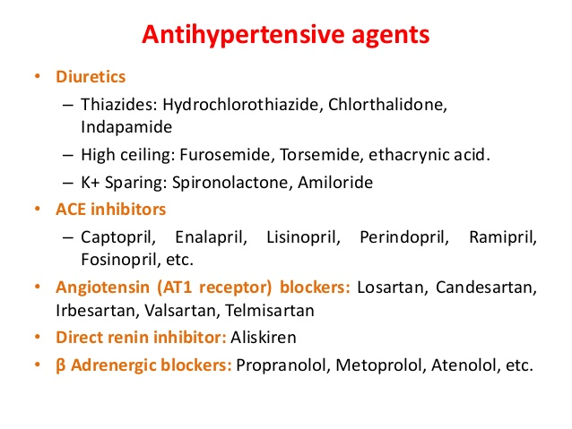

Slide 8
Anti-Epilepsy
Epilepsy causes your brain to send abnormal signals. This activity can lead to seizures. Seizures can occur for a number of reasons, such as injury or sickness. Epilepsy is a condition that causes recurrent seizures. There are several types of epileptic seizures. Many of them can be treated with antiseizure medications.

Slide 9
